Slide 1

Random Password Generator Computing Fundamentals for Engineers - EECE2140
Jason Zamarripa
Adil Ikiz
Klaidas Wikar

Slide 2
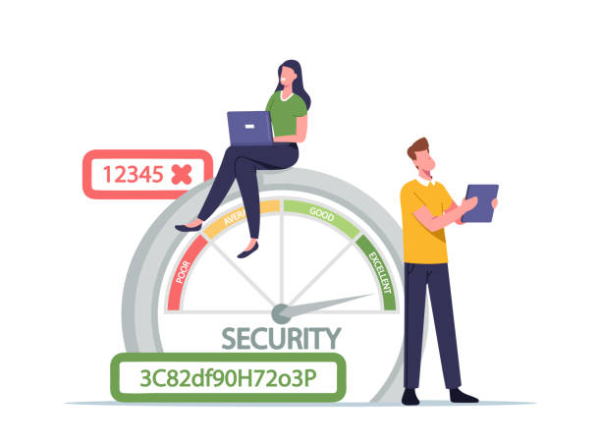
Introduction
Objectives-
Strong Password
Never the same Password
Customization (Length, Characters, and Numbers)
Goals-
Output sent to the user's email
Familiarization with the class system

Slide 3
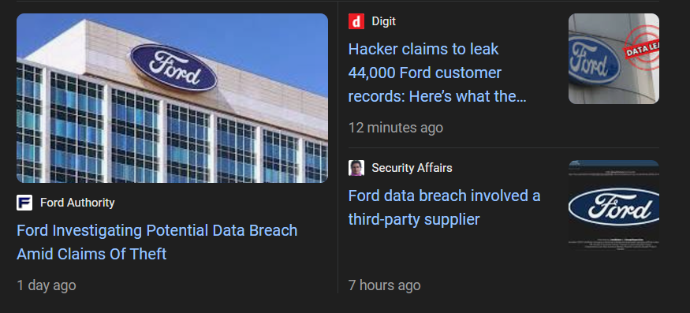
Project Scope
Background-
Password for everything
Need for security
Data breaches
Problem Statement-
Find a way to create a random password with user defined specifications and get it to the user without showing others the output

Slide 4
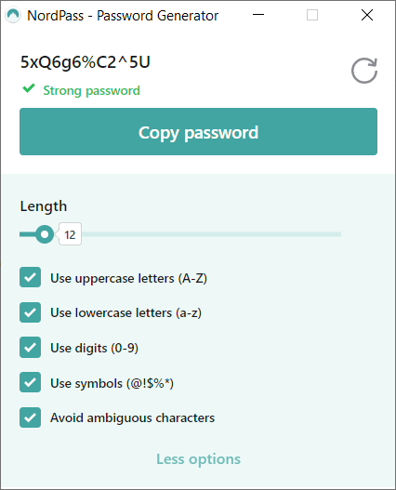
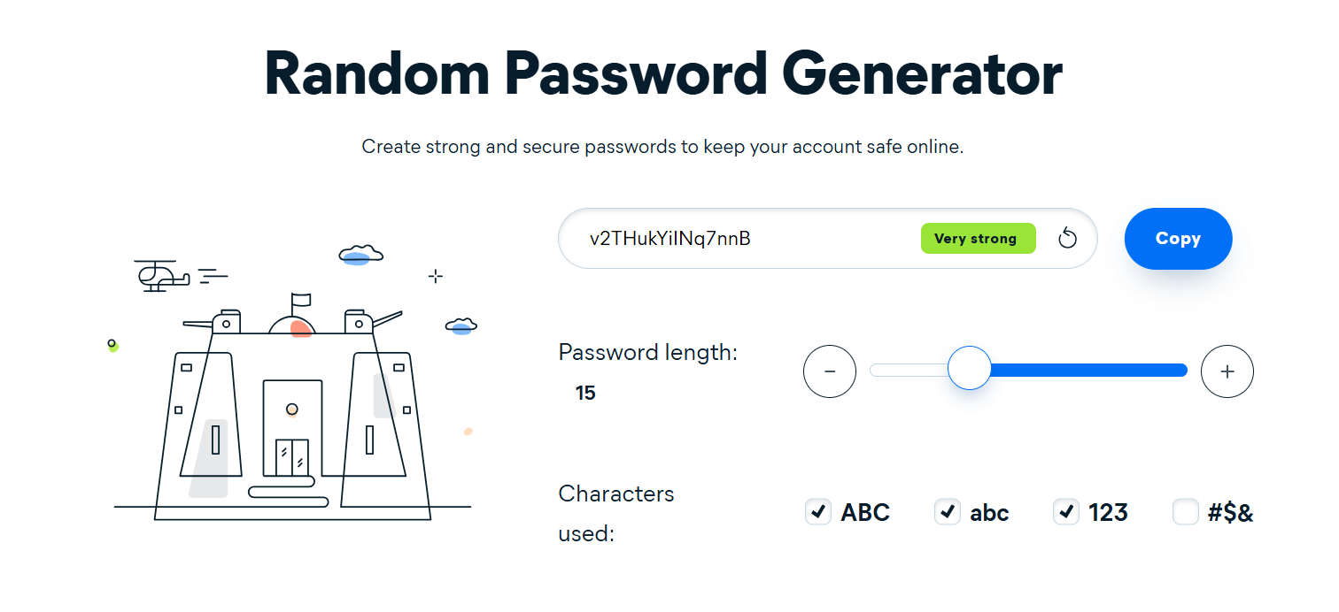
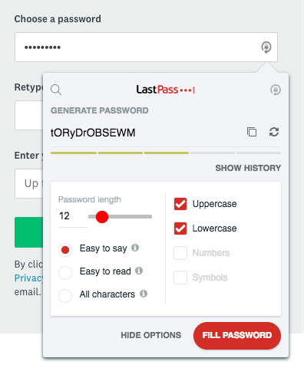
Literature Review
Existing work -
Last Pass
Nord Pass
Avast
Similar Features -
Customization
Do not save the password
Yes / No option for the customization

Slide 5
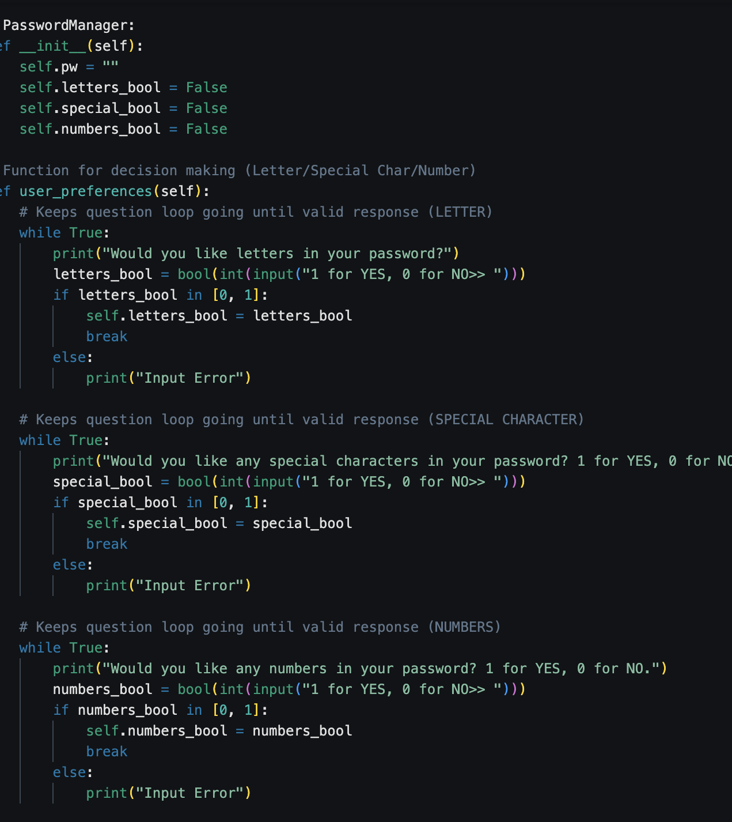
Methodology
Classes -----> modular and scalable
Password Generation ---> add to string ---> add to password list
Input validation and error handling
Loop ---> correct input? & incorrect input
Email error? ---> print error
DATA TYPES:
Lists
Strings
Integers

Slide 6
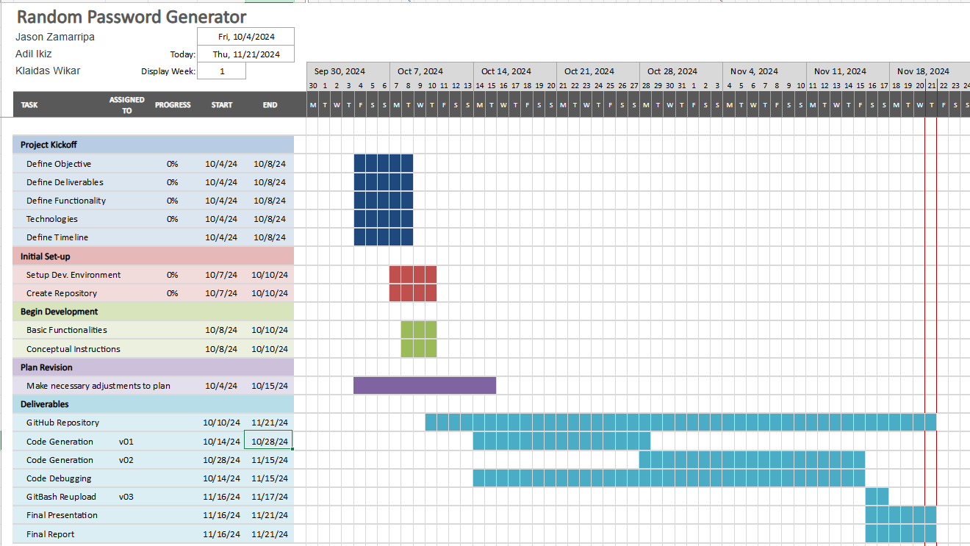
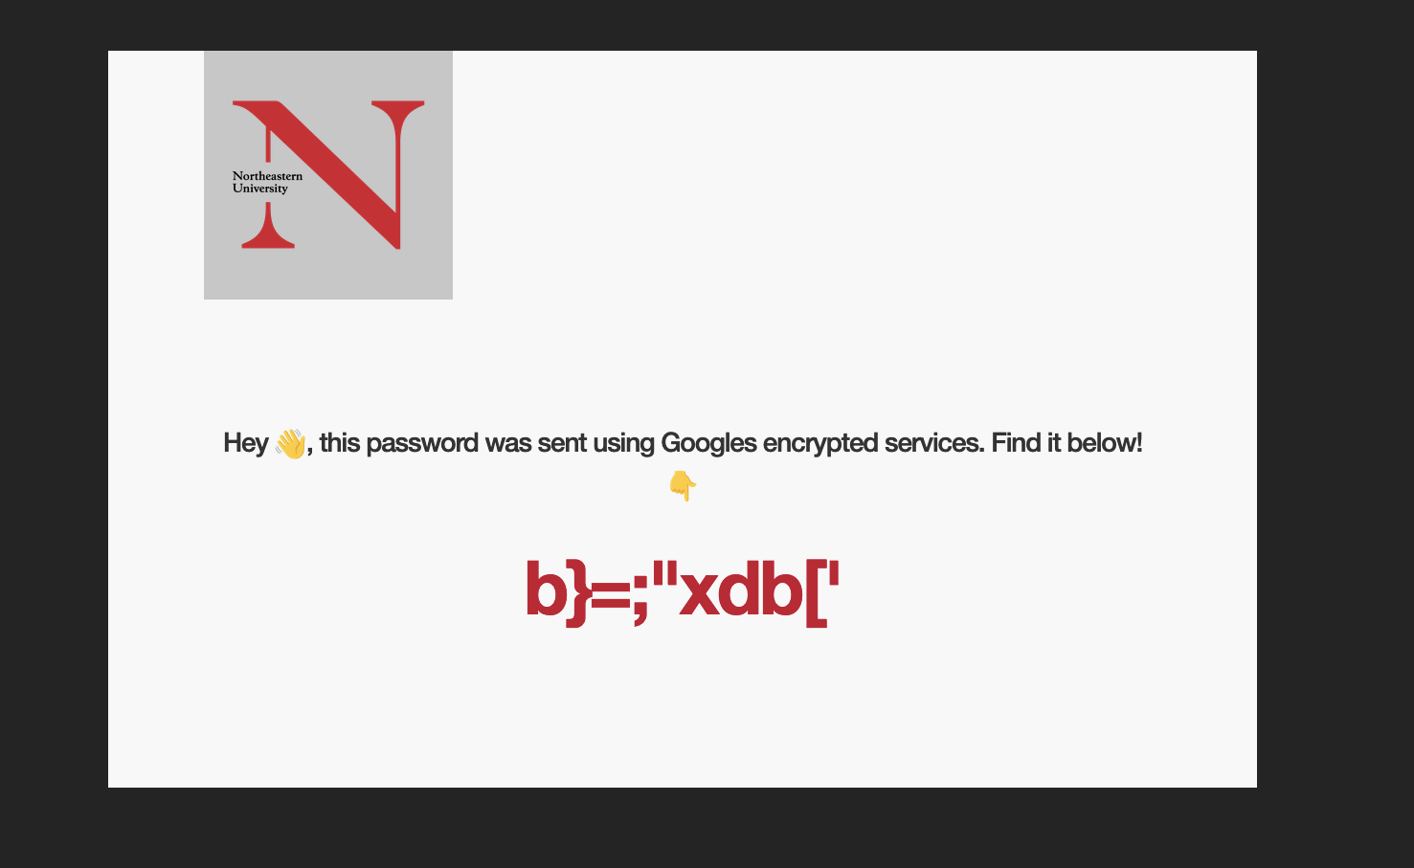
Analysis and Results
3-4 Hours Per Week per person
Mixed worked division
Key Findings:
GitHub
HTML & Google Services Linkage
OOP
Interpretation of Results
CLI

Slide 7
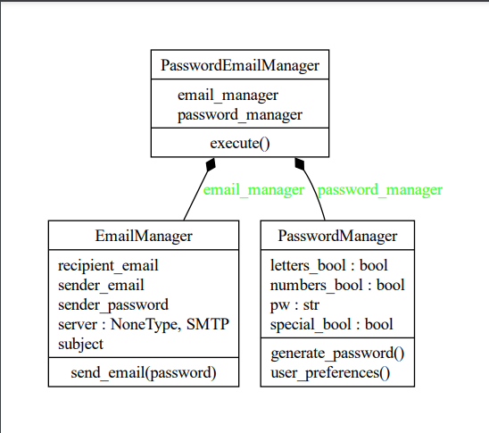
Discussion
(Version 01) Method generation for determining user preferences
Functional Prototype
(Version 02) Method Generation for Email compiling & Sending
Google Gmail Services
Error handling
Classification & Modularity
(Version 03) GitBash Reupload

Slide 8
Conclusion
Conclusions from the project
Meets objectives and goals
Secure and customizable
Email standards (MIME)
Recommendations for Future work
Save passwords
Add phrases
Browser extension
SMS messages

Slide 9
References
List of All Cited Sources
https://www.avast.com/en-us/random-password-generator#pc
https://nordpass.com/password-generator/
https://www.lastpass.com/features/password-generator
https://www.webroot.com/us/en/resources/tips-articles/how-do-i-create-a-strong-password
https://stackoverflow.com/questions/6270782/how-to-send-an-email-with-python

